Slide 1


Unicorns Analysis
- Unsupervised Machine Learning techniques applied -
BUSINFO 703 | Group A1 | Nov 2024

Slide 2

Agenda
Overview of Unicorns
Methodology Applied
VC Investors Pattern Discovery
Unicorns’ Company Profiling
Copyright © HT Media 2022. All rights reserved. 5

Slide 3




Overview
Count
507 Unicorn Companies
38 Countries
Geographic (Top 5)
293 United states
53 China
31 India
21 United Kingdom
14 Canada
95 Other 33 countries
Year/Valuation
Most companies Joined unicorn in 2021
Top 2 ByteDance, SpaceX
Industry
32.54% Enterprise Tech
19.53% Financial Services
15.38% Consumer & Retail
14.79% Industrials
17.76% Others

Slide 4
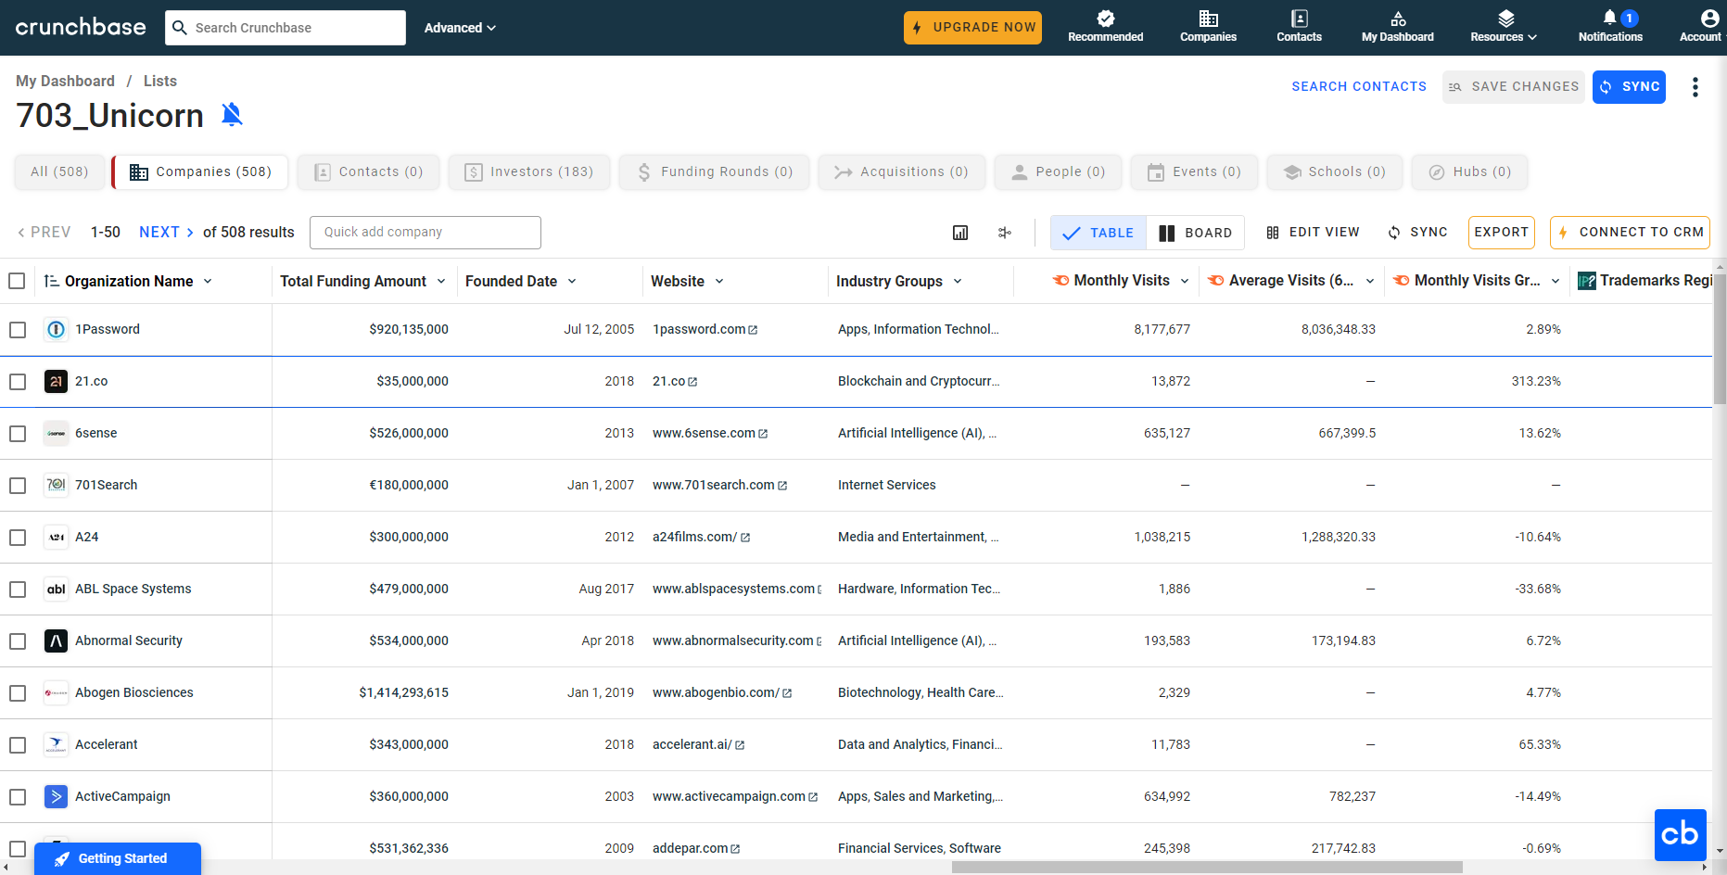
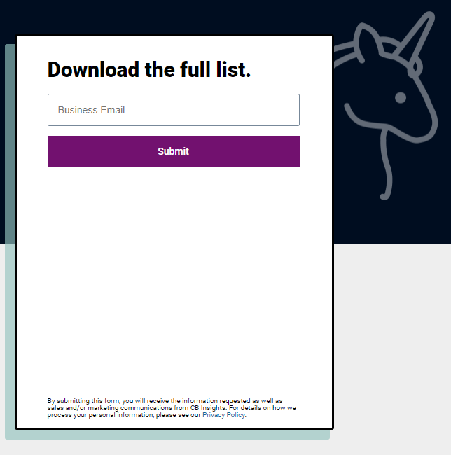



Methodology applied
Data Sourcing > Cleaning > Machine Learning > Analysis
Web-scraped 40+ unicorn company variables
Instant Web Scraper chrome extension​

Slide 5
Data Cleaning & Combining
1
Choose Unicorn dataset from CBINSIGHTS
1
Use Python/Excel/PowerBI to clean the datasets
2
Indicator datasets
WorldBankData:
GDP
Ease of doing business
Government education expenditure
Total patent application
High-Technology exports(% manufactured exports)
Medium and high-technology manufacturing value added(%)
2
Ensure consistent data format and datatype across all the datasets
3
Take the data for 2019, as this minimizes the extent of missing values
4
Merge the datasets by country, company name for further analysis

Slide 6
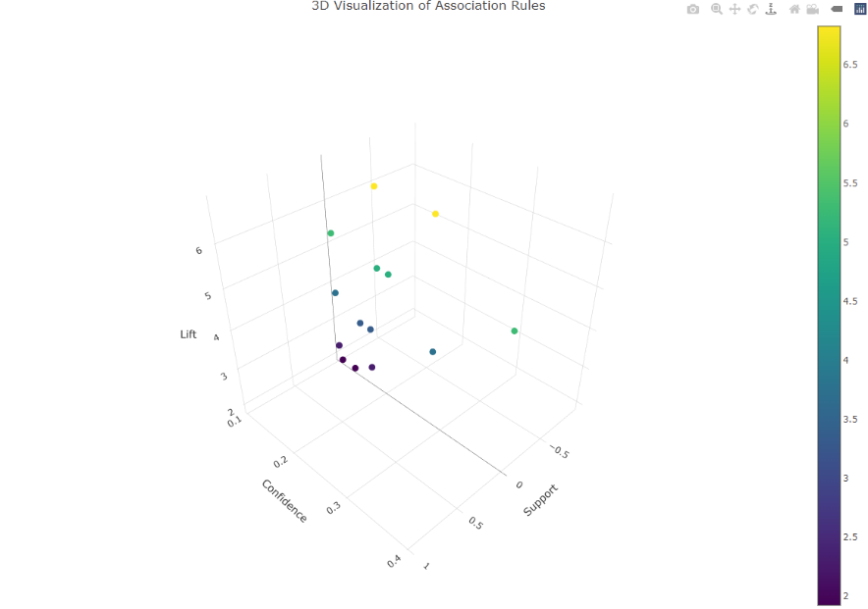

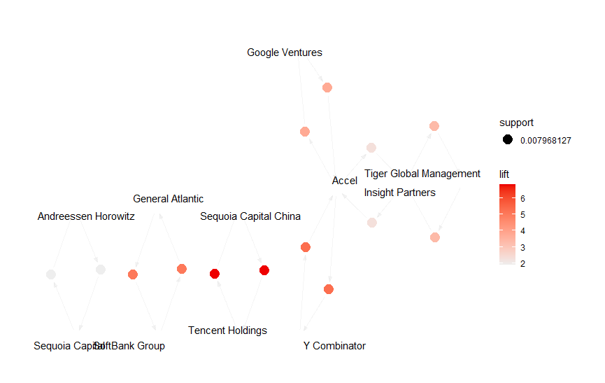
VC Investors Pattern Discovery
3D Visualization of Association Rules
Association rule mining using the Apriori algorithm
Metrics: lift > 1 & support > 0.007 & confidence > 0.05
Implemented through the arules and arulesViz packages
Visualized with scatter plots and 3D plots using plotly.
Source: Created using RStudio (File Uploaded)
Network Graphs
Source: Created using RStudio (File Uploaded)

Slide 7







VC Investors Pattern Discovery
Among top-tier VC firms, alliances and co-investment patterns are discovered.
Strong relationships (positive association far beyond chance) exist between certain VC firms.
Tencent Holdings
Sequoia Capital China
Lift = 6.83
Y Combinator
Accel
Lift = 5.28
SoftBank Group
General Atlantic
Lift = 5.03

Slide 8
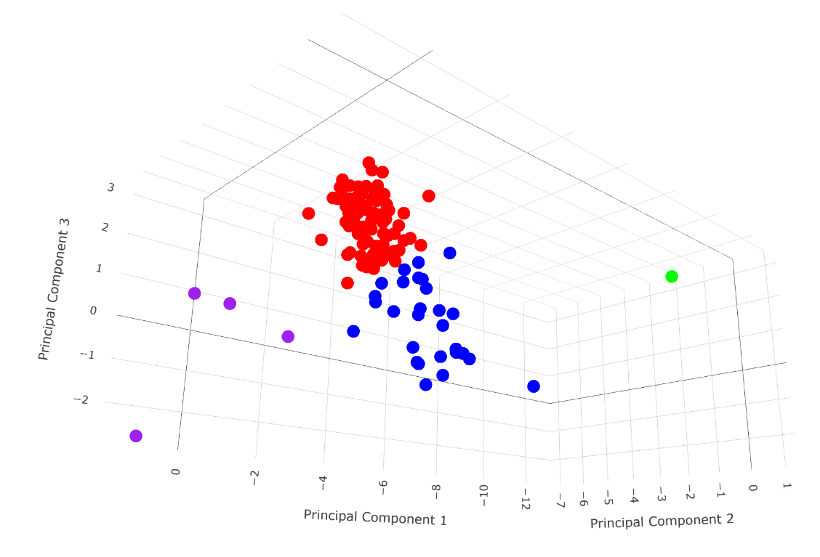


Unicorn Company Clustering
TARGET SELECTION
Country: United States (57%)
Industry: Enterprise Tech (44%)
Cluster Mapping using Principal Component Analysis
Clusters
702.75 Billion (122 Companies)
Clusters:
1. Emerging Unicorns (89 companies)
2. High-Value Growth Leaders (28 companies)
3. Established Titans (1 company)
4. Intellectual Property Champions (4 companies).
Source: Created using RStudio (File Uploaded)

Slide 9



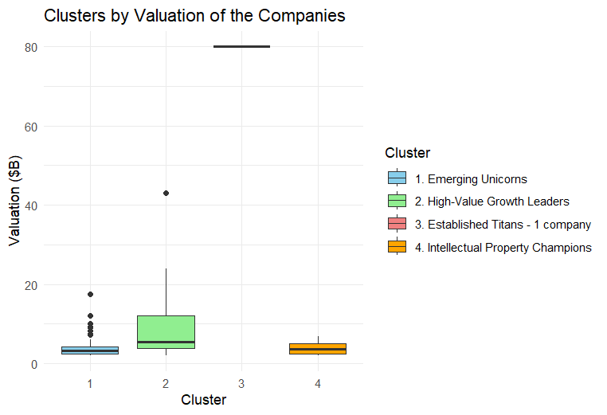
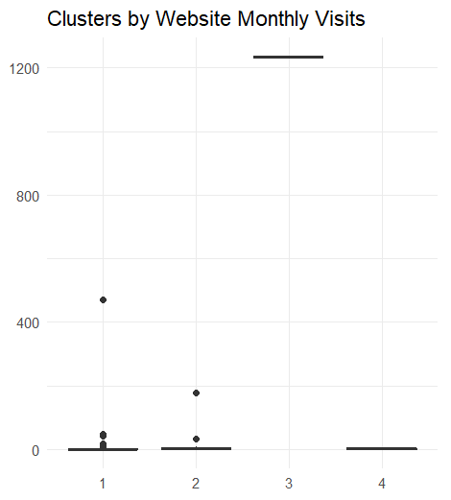
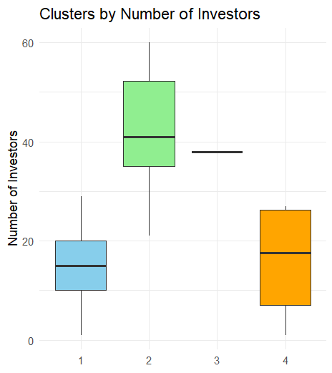
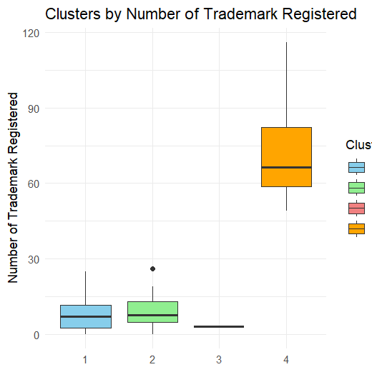
Unicorn Company Clustering
Cluster 1: Emerging Unicorns
3.95B 15.4 8.53 8.5M
Growing companies with strong investor backing.
Cluster 2: High-Value Growth Leaders
9.1B 42.6 9.93 1 10.1M
High valuations and robust investor confidence.

Slide 10
Unicorn Company Clustering
Cluster 3: Established Titans
80B 38 3 1234M
High valuation and web engagement
Cluster 4: Intellectual Property Champions
4B 15.8 74.5 1.6M
Niche innovation leaders.
Source: Created using RStudio (File Uploaded)

Slide 11
Implication of the Clustering
Cluster 2 is the best cluster for the investors:
Well past the risky startup phase, reducing the likelihood of failure.
42.6 investors on average per company, a clear sign investor confidence.
Cluster 3 has only 3 Trademarks indicating that these companies may be more focused on operational efficiency than innovation.
Cluster 4 has trademarks but they lack in web engagement, likely because they are not exciting.
Cluster 1 moderate valuations and limited investor backing make them riskier.
Source: Created using RStudio (File Uploaded)

Slide 12
Implication of the Clustering
Cluster 1 is the focus for the policy makers:
There is a need to support Emerging Unicorns (Cluster 1) by fostering a favorable ecosystem that can help these companies scale rapidly.
Additionally, focusing on IP development can further strengthen the USA's leadership in the Enterprise Tech industry.
Source: Created using RStudio (File Uploaded)

Slide 13


Who’s next?
Questions next -

Slide 14

Appendix
Datasets:
1. CBInsight Unicorn tracker (as of September 2024)
https://www.cbinsights.com/research-unicorn-companies
2. Crunchbase
https://www.crunchbase.com/lists/703-unicorn/a8cde573-b508-4cdb-bc70-b16e804fcd6f/organization.companies
3. World Bank
World Bank Open Data | Data
Copyright © HT Media 2022. All rights reserved. 7

